Slide 1
EDISON Project in Nanophysics/electronics - Current status of contents and service -
Hoon Ryu, Ph.D.
National Institute of Supercomputing and Networking,
Korea Institute of Science and Technology Information.
elec1020@gmail.com

Slide 2
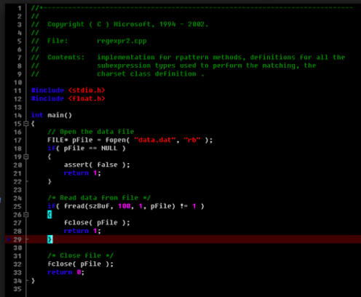
Technology-Computer-Aided-Design
TCAD?
Group of tools
- Predict “real world” by computing, critical to save time/money/manpower etc.
Large-scale problems in various fields of science
- With aids of HPC. “Computational Science” now “an area of research”
If you are a developer and a scientist - OK. I know you’re great, BUT
Should a person know everything to do modeling/simulation-based research?

Slide 3
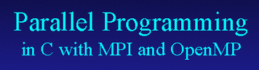
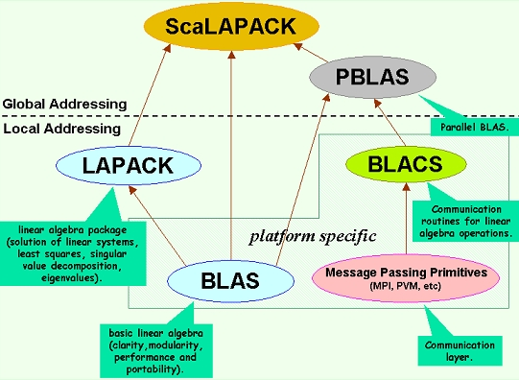
Technology-Computer-Aided-Design
TCAD?
Group of tools
- Predict “real world” by computing, critical to save time/money/manpower etc.
Large-scale problems in various fields of science
- With aids of HPC. “Computational Science” now “an area of research”
If you are a developer and a scientist - OK. I know you’re great, BUT
Should a person know everything to do modeling/simulation-based research?

Slide 4
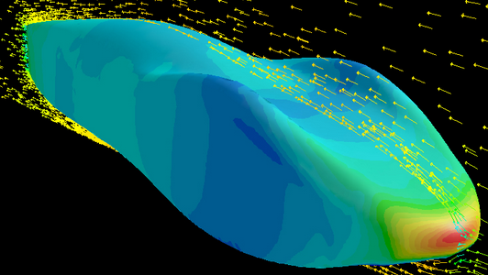
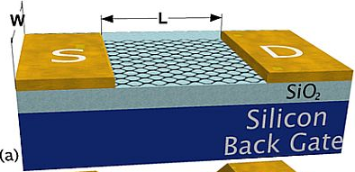
Technology-Computer-Aided-Design
TCAD?
Group of tools
- Predict “real world” by computing, critical to save time/money/manpower etc.
Large-scale problems in various fields of science
- With aids of HPC. “Computational Science” now “an area of research”
If you are a developer and a scientist - OK. I know you’re great, BUT
Should a person know everything to do modeling/simulation-based research?

Slide 5
Technology-Computer-Aided-Design
TCAD?
Group of tools
- Predict “real world” by computing, critical to save time/money/manpower etc.
Large-scale problems in various fields of science
- With aids of HPC. “Computational Science” now “an area of research”
If you are a developer and a scientist - OK. I know you’re great, BUT
Should a person know everything to do modeling/simulation-based research?
Why don’t we make people a bit happier?
Easy Access to Simulations
Efficiency of Learning – Let people experience interactively!
Strong motivation to “Take the pain” for learning all the technical details

Slide 6
Science Gateway: The EDISON Project
“Easy Simulation” is the keyword for increasing efficiency in EDU/Research!!
Initiation of the EDISON Project
(EDucation-research Integration through Simulation On the Net)
Started in 2011 July under governmental support
Initiative domain: Computational Fluids Dynamics (CFD)
Moving to the 2nd step: Towards “new” scientific domains.
2012 July, we have started to support two new domains
Computational Chemistry and Computational Nanophysics
Objective of remaining talk – Focusing on the nanophysics
A brief Introduction of EDISON_Nanophysics
- Motivation and Objectives
- Current Status of Services
- Summary of available TCAD software

Slide 7
LANCZOS algorithm
□ Algorithm: Flowchart of iterations [1][2]
Nano + Physics + Electronics?
Small – everything is new in terms of theory
Nanoscale Materials
Nanoscale Devices
Fundamentals of Theory
* Solid-state, Quantum Physics, Semiconductors Crystalline ETC

Slide 8
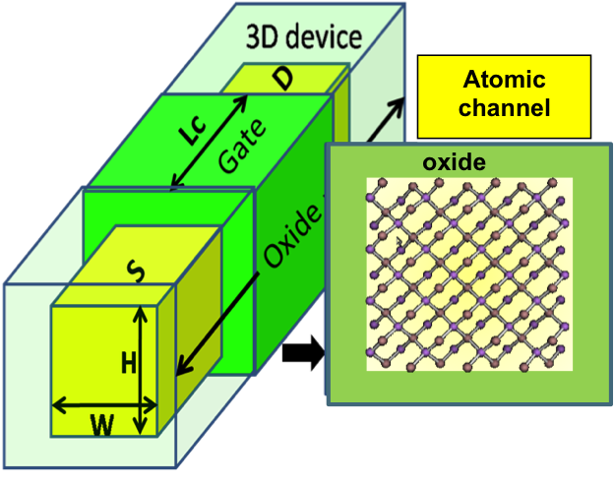
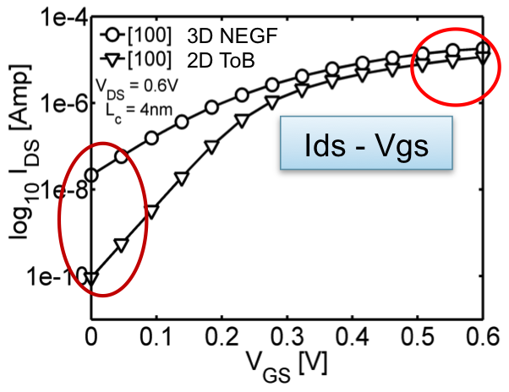
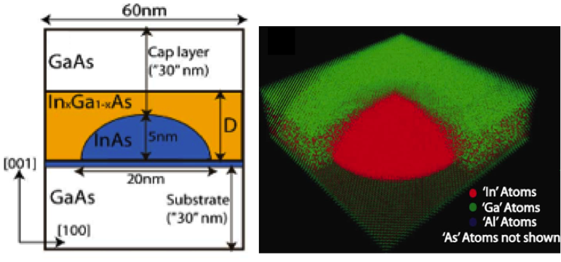
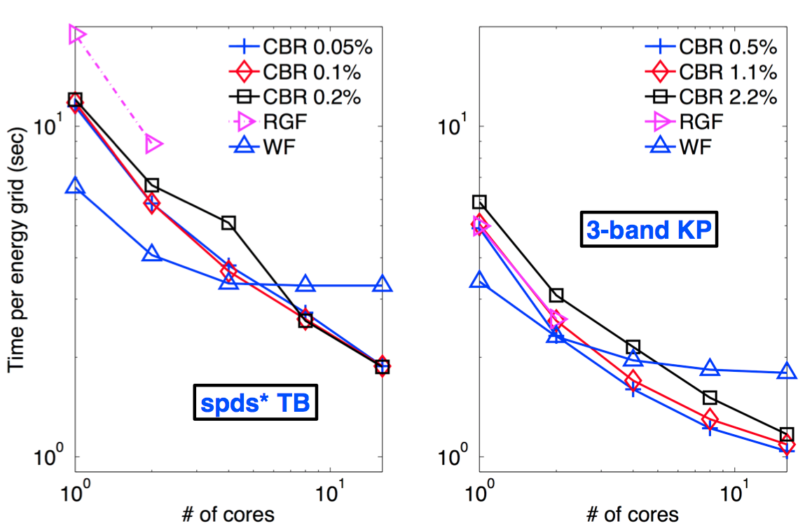
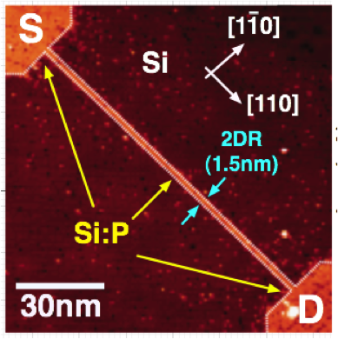
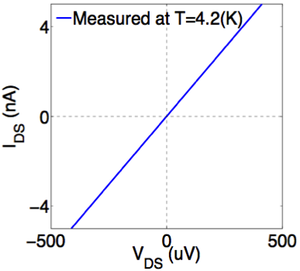

LANCZOS algorithm
□ Algorithm: Flowchart of iterations [1][2]
Nano+Physics+Electronics - Research
Si Devices: Transport in FETs
III-V Devices:
Optoelectronics - Photodetectors
Performance-degradation in nanoscale FETs.
Needs for 3-D NEGF simulation.
Engineering of III-V Quantum Dot Optical Gaps with Strain-reducing Capping Layers.
IEEE Trans. Elec. Dev (2010)
IEEE Trans. Nanotech. (2012)
IEEE Elec. Dev. Lett. (Under Review)
IEEE Trans. Nanotech. (2009)
Math. Comp. Model. (2013)
New Material: Si:P Devices
Algorithm: Parallel Solver
Metallic Property of P δ-doped Nanowires.
Sensitivity to channel dopant distributions.
Quantum Transport: Contact Block Reduction vs. Recursive Green’s Function.
Electronic Structure: Deflation LANCZOS for calculation of spin-degenerate states.
J. Appl. Phys. (2012)
Math. Comp. Model. (Under Review)
Phys. Rev. B (2011), Science (2012),
Nat. Nanotech. (2012, 2014) Nanoscale (2013)

Slide 9


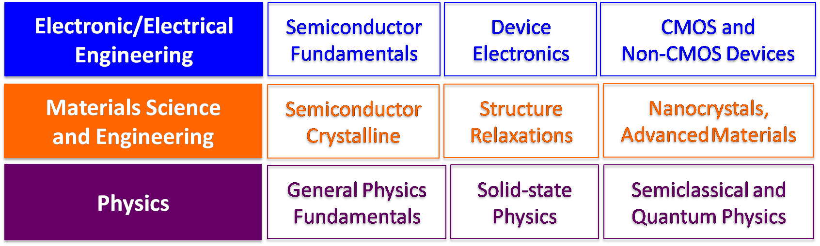
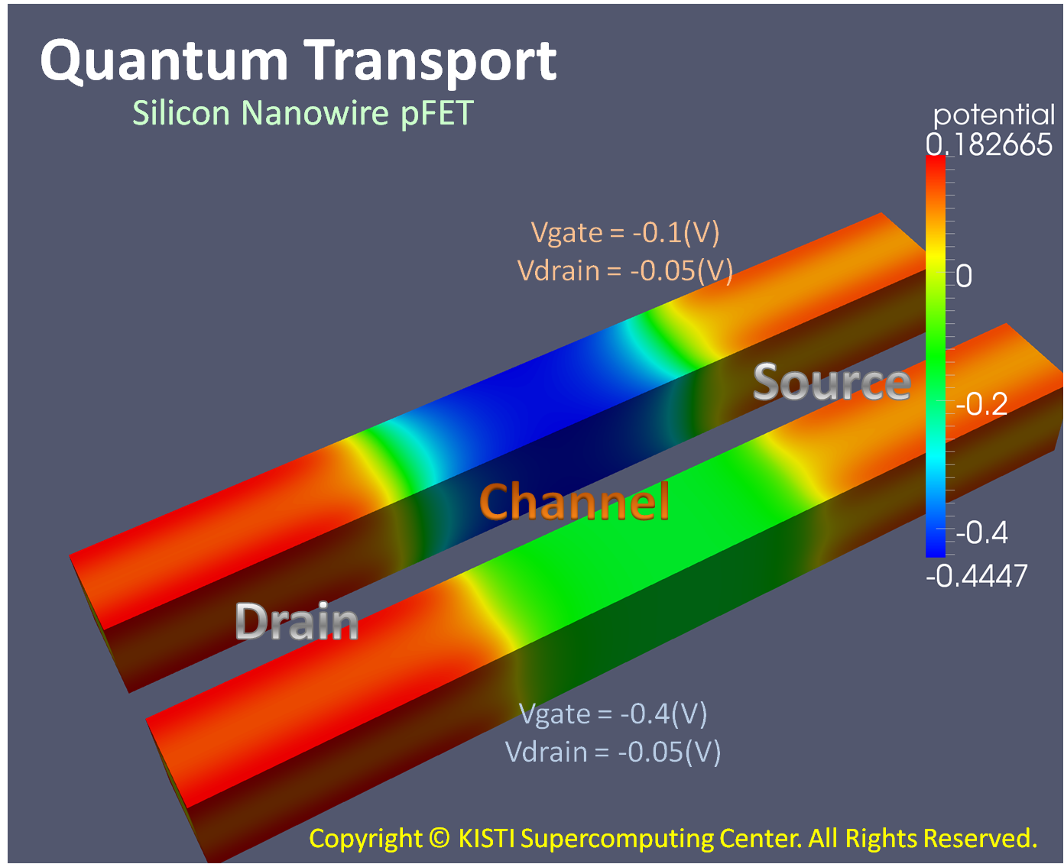
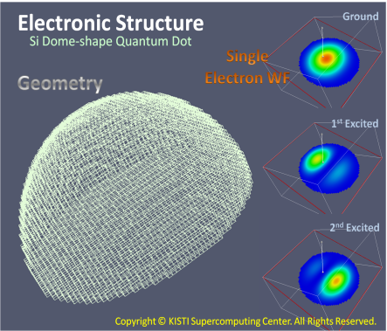
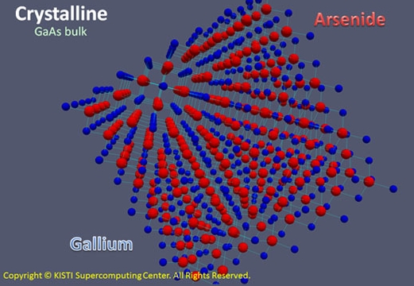
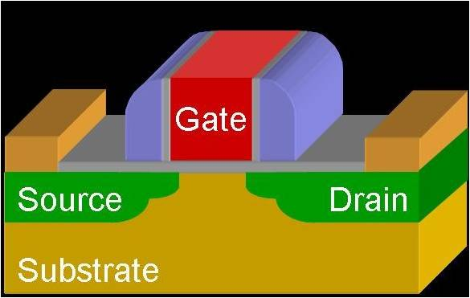
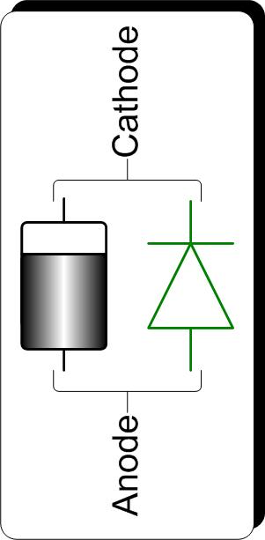
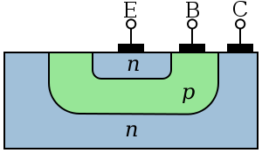
LANCZOS algorithm
□ Algorithm: Flowchart of iterations [1][2]
Nano+Physics+Electronics - Education
Physics
Fundamentals
Advanced
Materials
Advanced
Devices

Slide 10
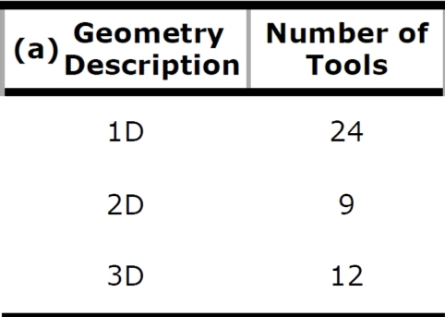
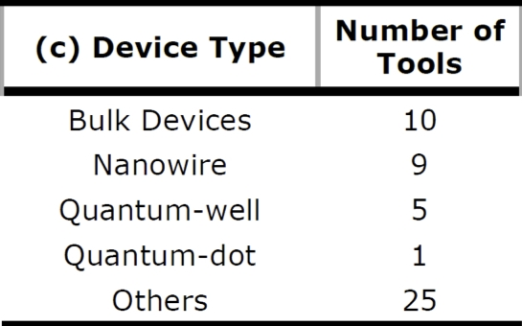
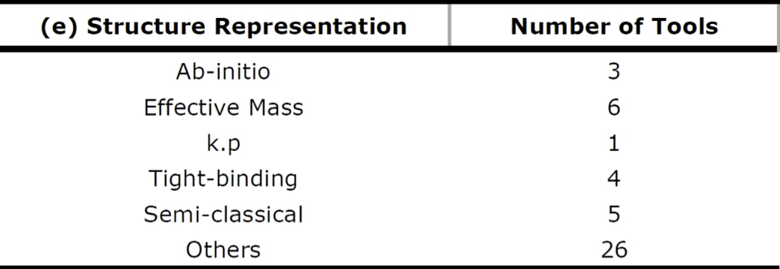
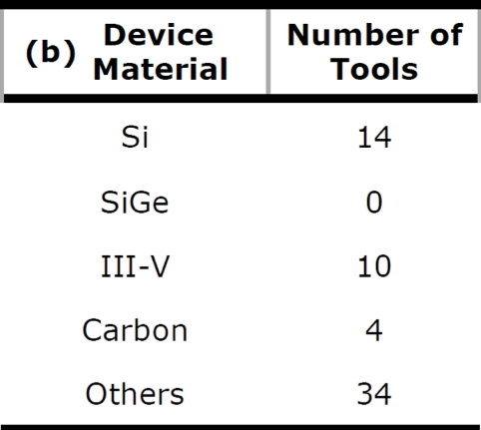
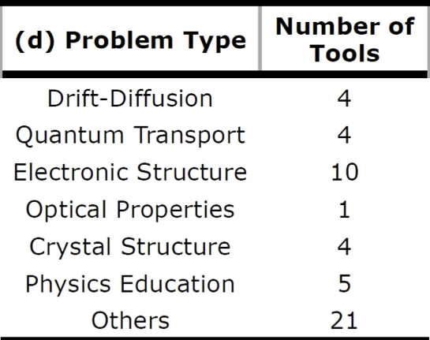
LANCZOS algorithm
□ Algorithm: Flowchart of iterations [1][2]
EDISON_Nanophysics: Available TCAD SWs
As of today, a total of 45 TCAD Tools are available
Tools are categorized by a set of problem filters
Five big categories: Geometry/Material/Device/Problem/Structure Representation
Geometry
Material
Device Type
Problem Type
Structure Rep.
1D
Si
Bulk Devices
Drift-Diffusion
Ab-initio
2D
Si/Ge
Nanowires
Quantum Transport
Effective Mass
3D
III-V
Quantum-wells
Electronic Structure
k.p
C
Quantom-dots
Boltzmann Transport
Tight-binding
Others
Others
Optical Properties
Semi-classical
Crystal Structures
Others
Physics Education
Others

Slide 11
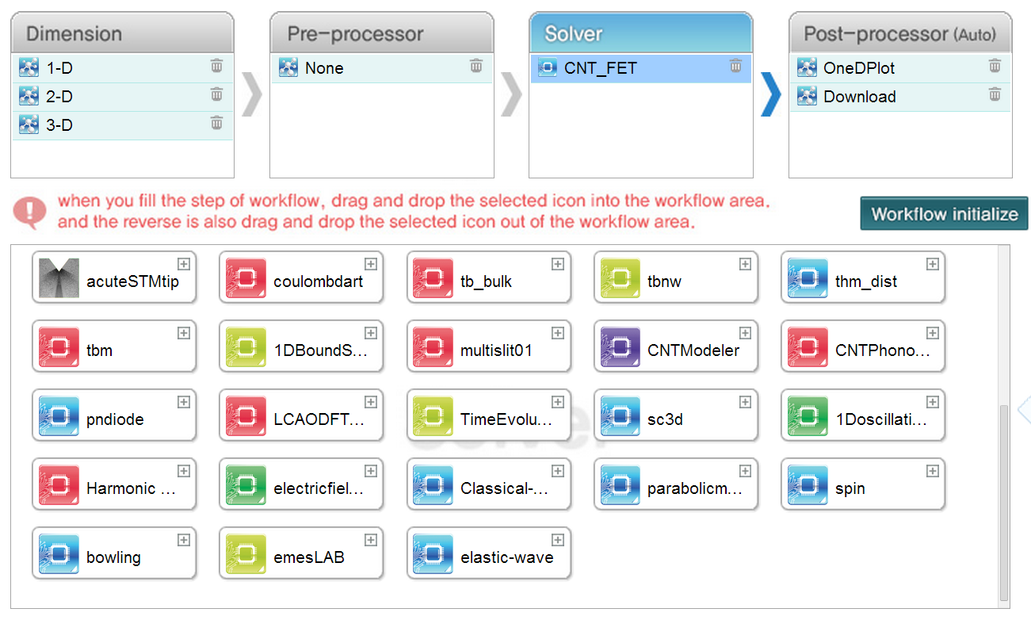
EDISON Nanophysics: Web-based Service
Remarks
- Native-web interface: Do not invoke GUIs through X-term. Light - a clear strength in resource overhead for supporting multiple job requests.
Job monitoring: Submitted jobs runs in the backend HPC. Provides a control interface of submitted jobs – In the case of X-term GUIs?
Easy Postprocessing: Simple, intuitive ways of visualizations and data-downloading
Four steps to support “easy simulations”
Users can select preferred tools
either by:
- combine workflow components
- combine problem filtering conds.
(Will show later again)

Slide 12
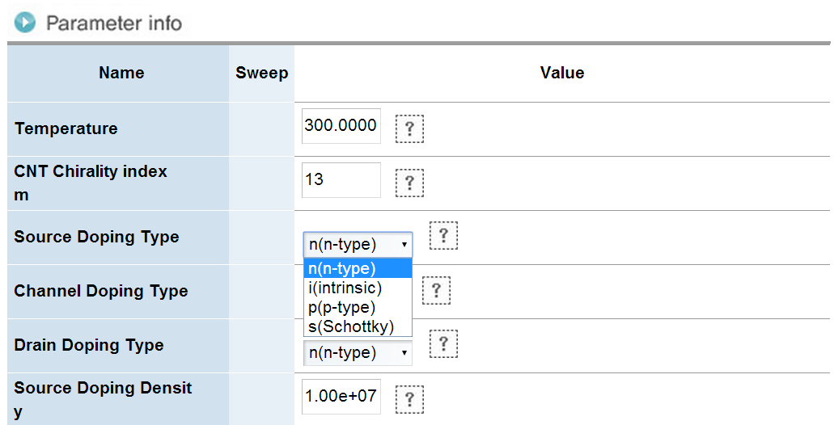
EDISON Nanophysics: Web-based Service
Remarks
- Native-web interface: Do not invoke GUIs through X-term. Light - a clear strength in resource overhead for supporting multiple job requests.
Job monitoring: Submitted jobs runs in the backend HPC. Provides a control interface of submitted jobs – In the case of X-term GUIs?
Easy Postprocessing: Simple, intuitive ways of visualizations and data-downloading
Four steps to support “easy simulations”
Control simulation parameters

Slide 13
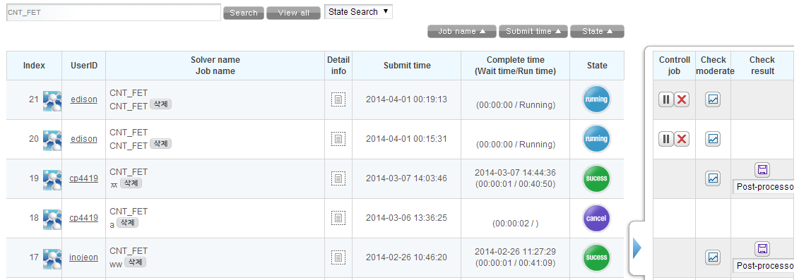
EDISON Nanophysics: Web-based Service
Remarks
- Native-web interface: Do not invoke GUIs through X-term. Light - a clear strength in resource overhead for supporting multiple job requests.
Job monitoring: Submitted jobs runs in the backend HPC. Provides a control interface of submitted jobs – In the case of X-term GUIs?
Easy Postprocessing: Simple, intuitive ways of visualizations and data-downloading
Four steps to support “easy simulations”
Control simulation parameters
Check the status of submitted
simulation jobs

Slide 14
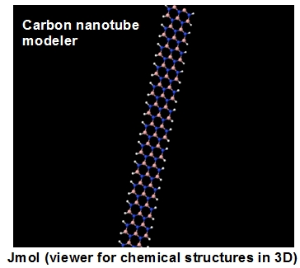
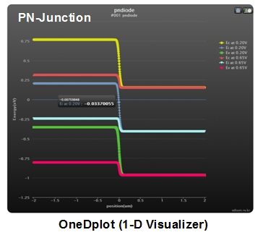
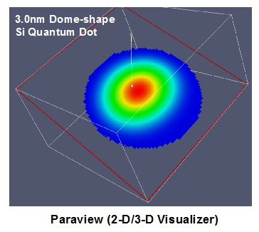
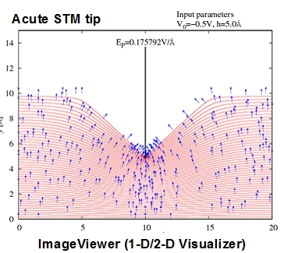
EDISON Nanophysics: Web-based Service
Remarks
- Native-web interface: Do not invoke GUIs through X-term. Light - a clear strength in resource overhead for supporting multiple job requests.
Job monitoring: Submitted jobs runs in the backend HPC. Provides a control interface of submitted jobs – In the case of X-term GUIs?
Easy Postprocessing: Simple, intuitive ways of visualizations and data-downloading
Four steps to support “easy simulations”
4 Vis. Interf.: oneDplot, Paraview (VTK), Jmol, Imageviewer
Directly downloadable for local processing

Slide 15
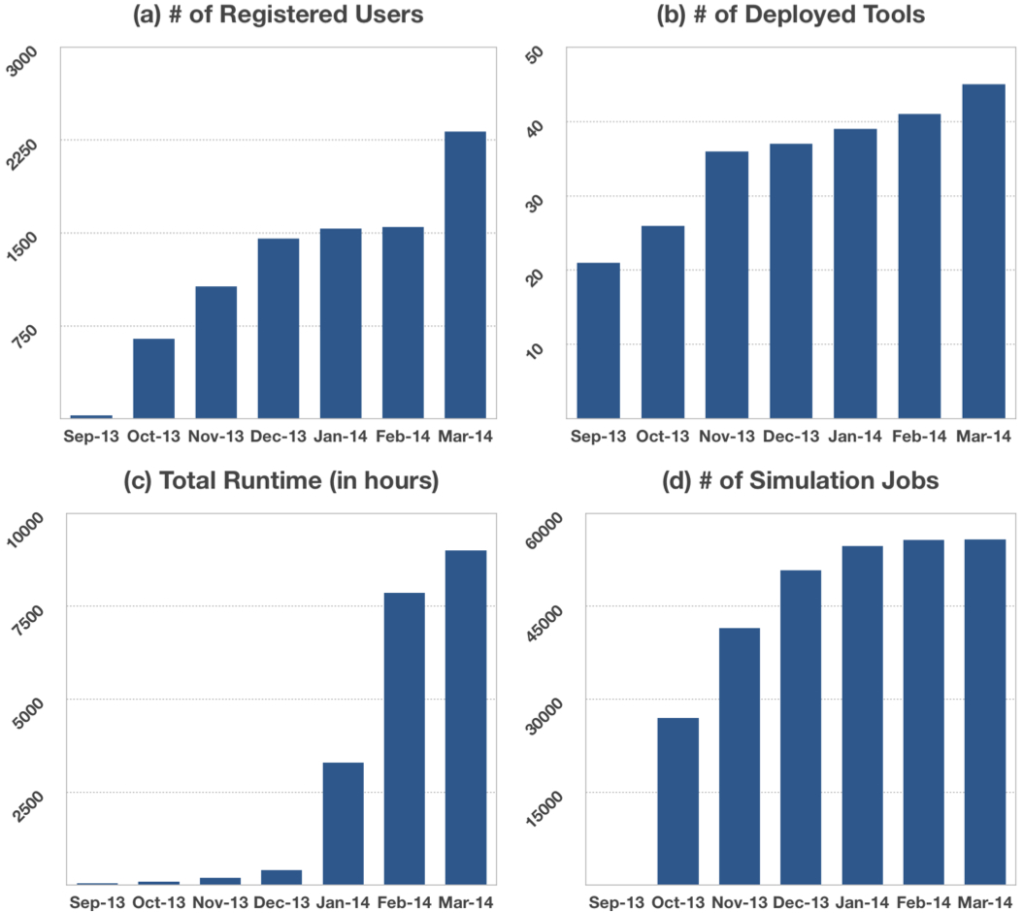
Current Status of Service Utilizations
Service Statistics
- Full service opened in 2013-Sep.
- 2300 domestic users.
- 45 TCAD Tools
- 50K jobs with wall-time of
~8K hours
Remarks
- 60 classes in 30 domestic
universities.
- “Open universities” have
joined our customers
** Korea National Open Univ.
- Biggest and Oldest National
Universities.
- We want to hear from you
now!

Slide 16
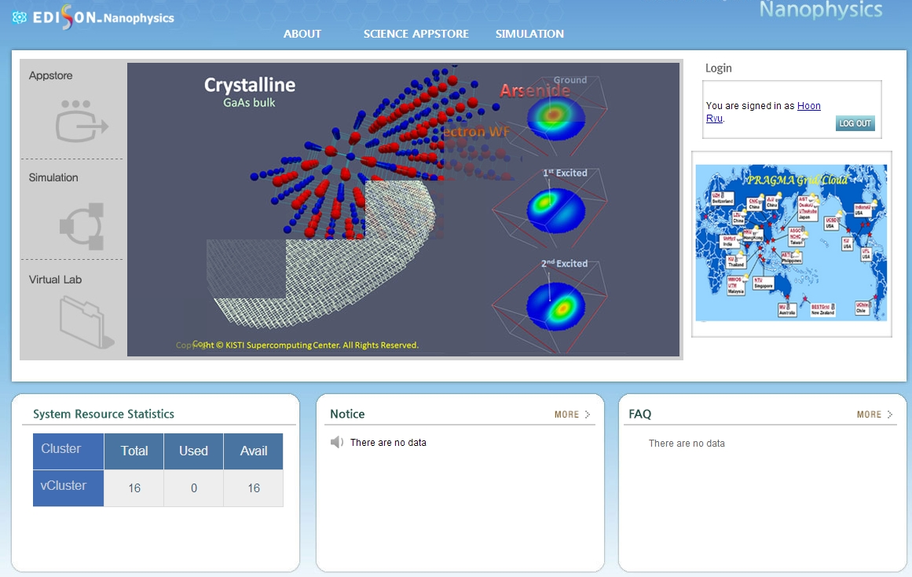
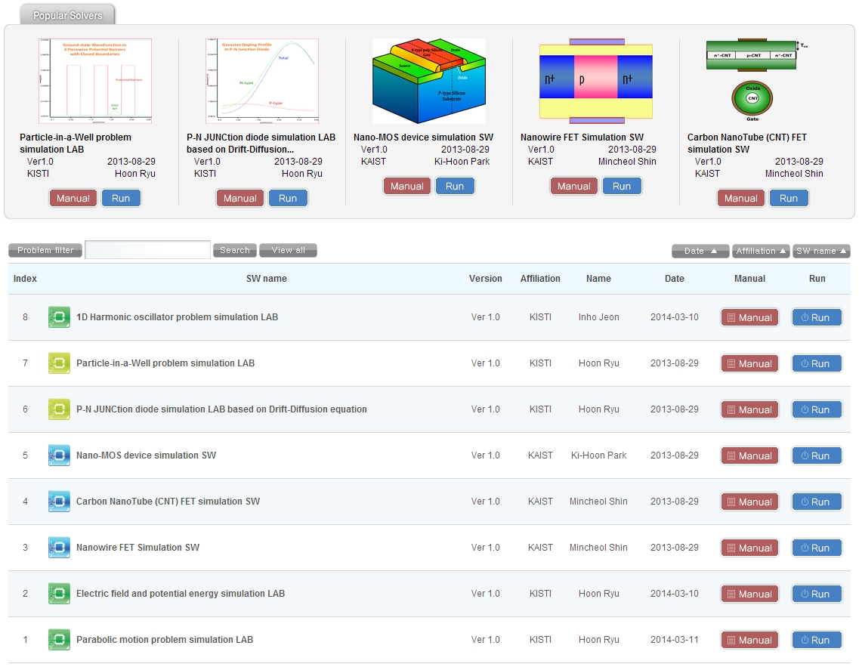
LANCZOS algorithm
□ Algorithm: Flowchart of iterations [1][2]
EDISON_Nanophysics GLOBAL
EDISON_Nanophysics for global users (~ 2014.Mar)
8 most popular tools are currently available. (Tool migration is ongoing)
http://nano.edison-project.org - Migration will be completed soon.
Tool Description
1D Harmonic Oscillator Problem Simulation LAB
Particle-in-a-box Problem Simulation LAB
P/N Junction Diode Simulation LAB
Nano-MOS Device Simulation LAB
Carbon NanoTube FET Simulation LAB
Nanowire FET Simulation LAB
Electric-field and Potential-energy Simulation LAB
Parabolic-motion Problem Simulation LAB
Physics
Fundamentals
Semiconductor
Fundamentals
Advanced Nanoscale Devices
User-guides to support self-study
Further Details: Demo Tomorrow!

Slide 17
Conclusions
A brief Introduction of EDISON_Nanophysics is given
- Motivation and Objectives
- Current Status of Services
- Summary of available TCAD software
Please consider EDISON for teaching and learning nanoscience in your school/institutes
- http://nano.edison-project.org
- Will give you further details about service tomorrow
Inquiries/Questions
- Dr. Ruth Lee (jsruthlee@kisti.re.kr) or Me (elec1020@gmail.com)
- Any fruitful comments would be appreciated
Do we have more time?
- Yes! then next.
- Thank you otherwise. ☺

Slide 18
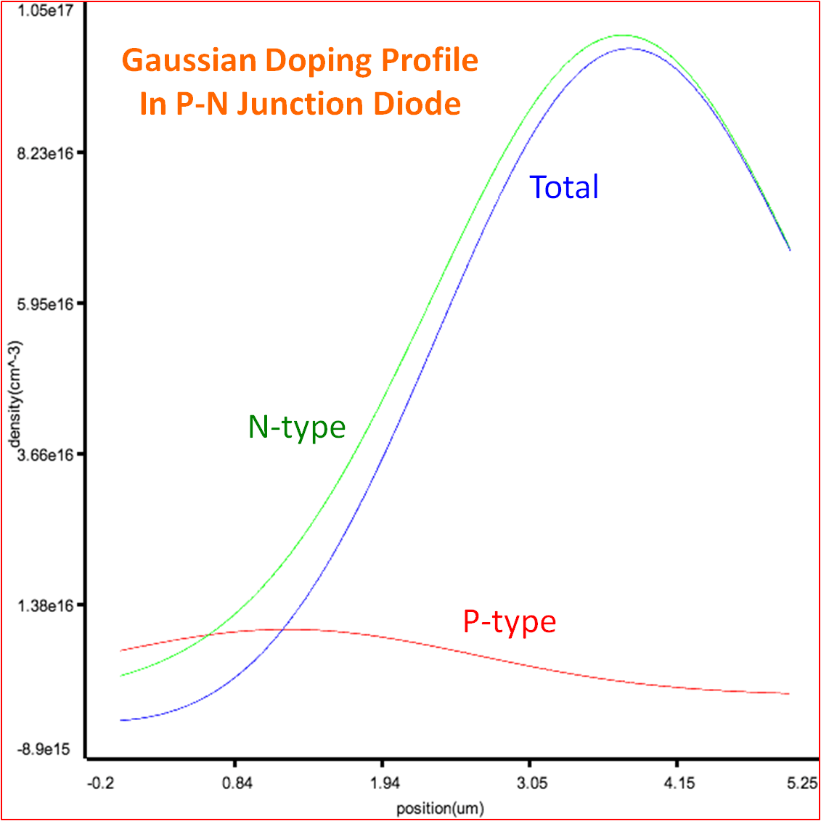
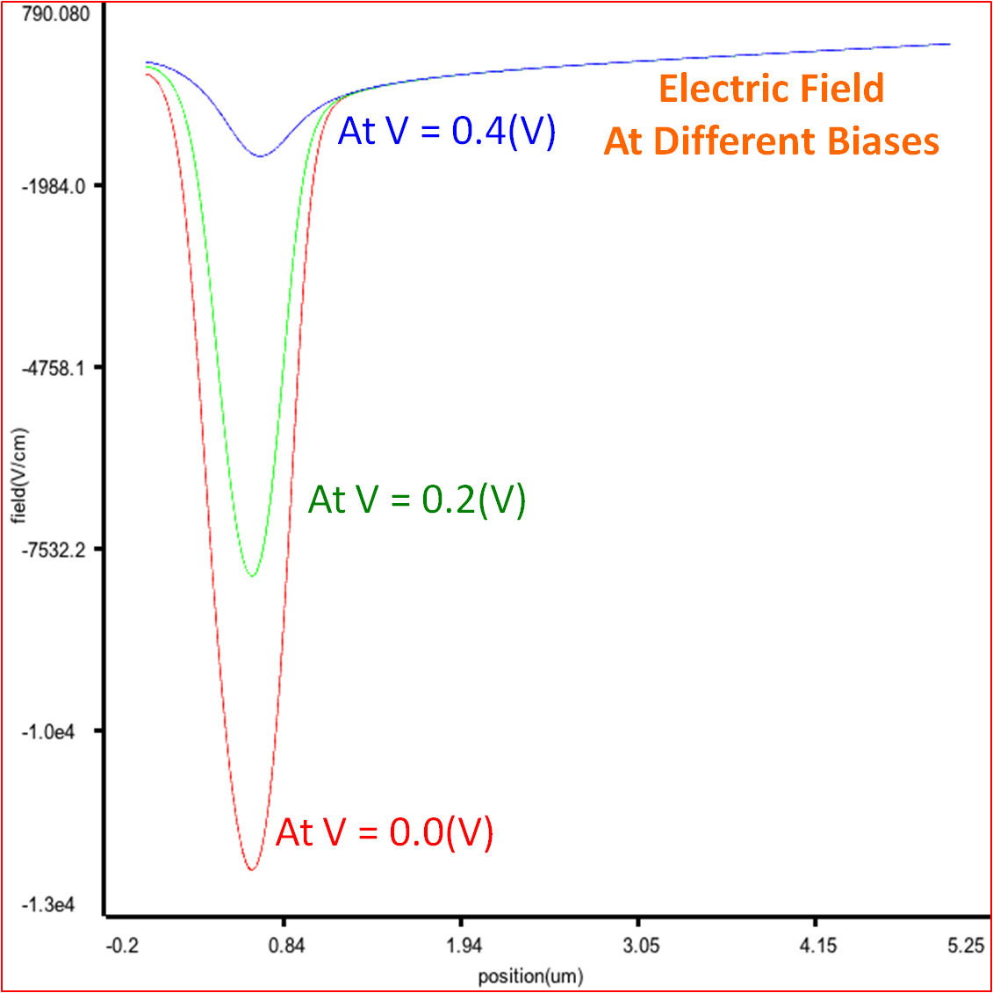
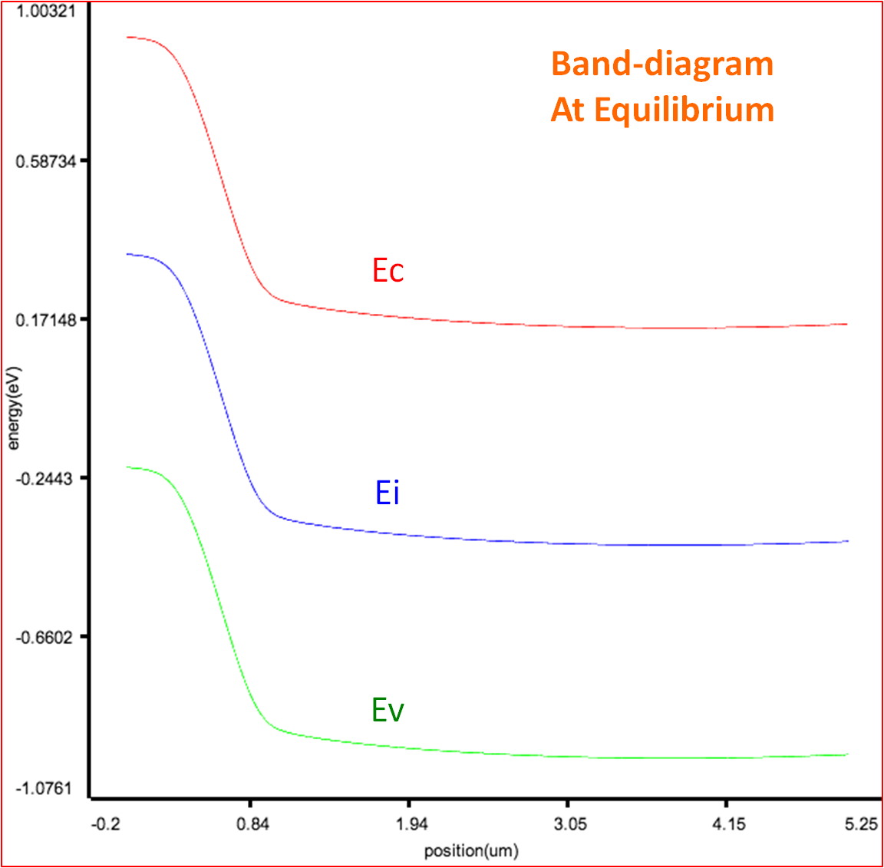
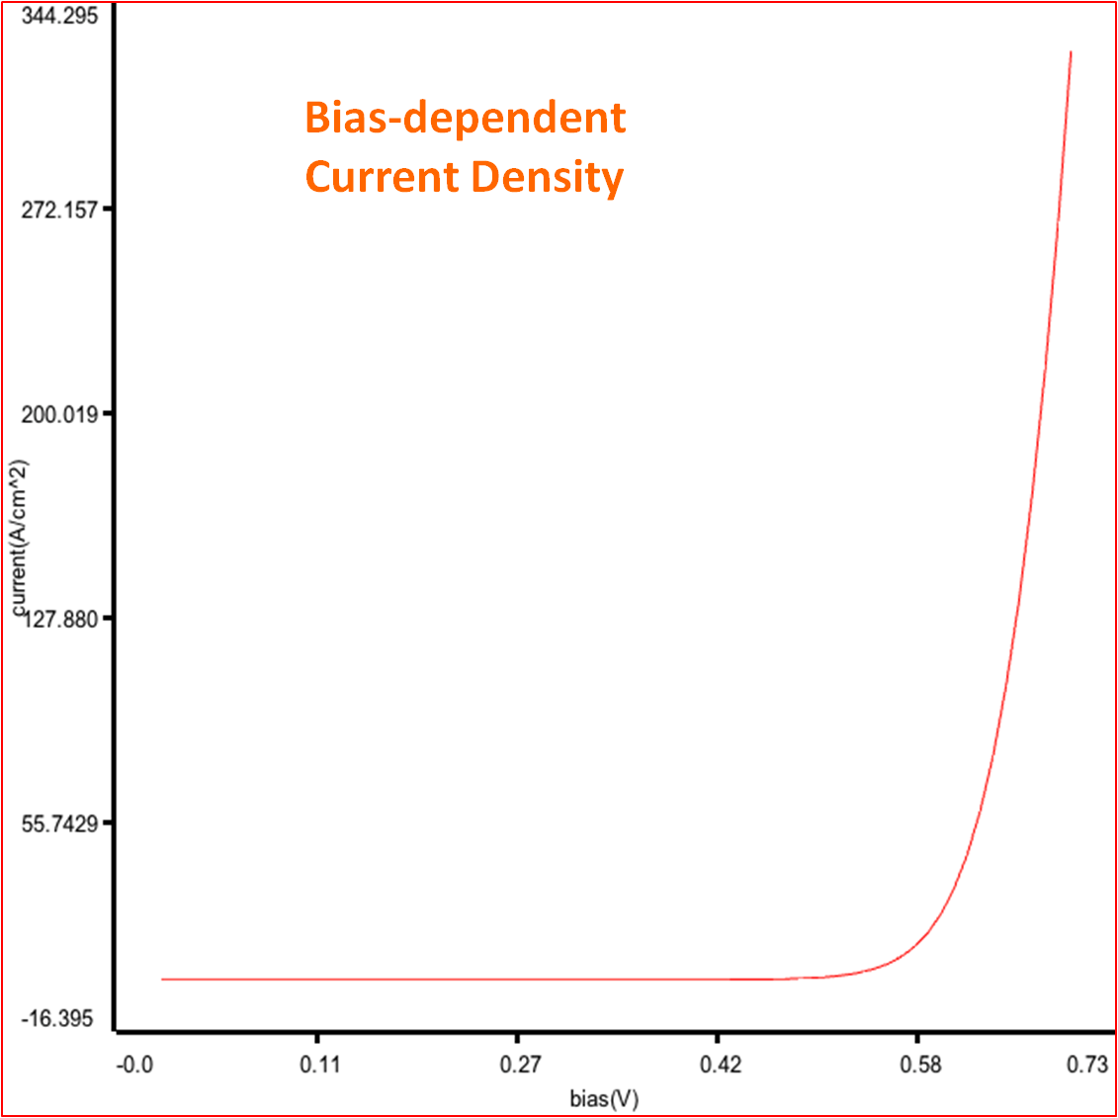
P/N Junction Diode Simulation LAB
Objective:
Diode: 2-terminal devices
Electronic performance of P/N junction diode – Design guide-line.
Platform of Development:
C++, ARPACK - Serial runs only
Features:
Calculate I-V characteristic of 2-terminal diode devices
Drift-diffusion equation
Support various doping profiles with which the I-V characteristic is hard to be computed with hands
Target of classes:
Fundamentals of semiconductors
Electronic Circuits
P/N Junction Diode: Gaussian doping profile

Slide 19
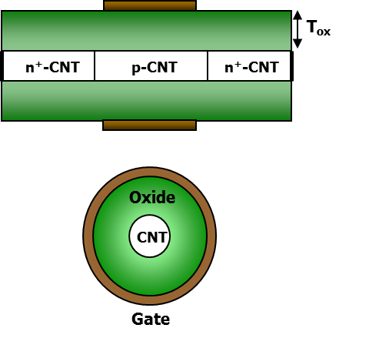
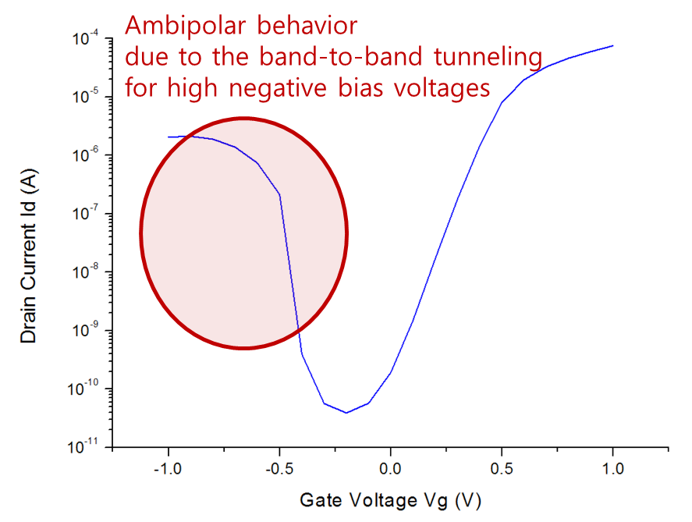
Carbon NanoTube Simulation LAB
Objective:
Simulate the electronic performance of CNT using a full quantum mechanical approach
Platform of Development:
C++, PETSc – Support parallel runs
Features:
I-V calculations using Non-Equilibrium Green’s Function (NEGF)
Ballistic Transport
Target of classes:
Advanced nanoscale devices
Research purpose
R=1nm, (13, 0) zig-zag pattern CNT

Slide 20
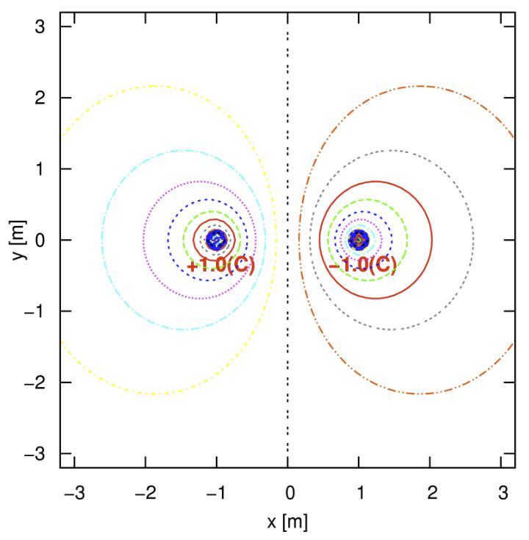
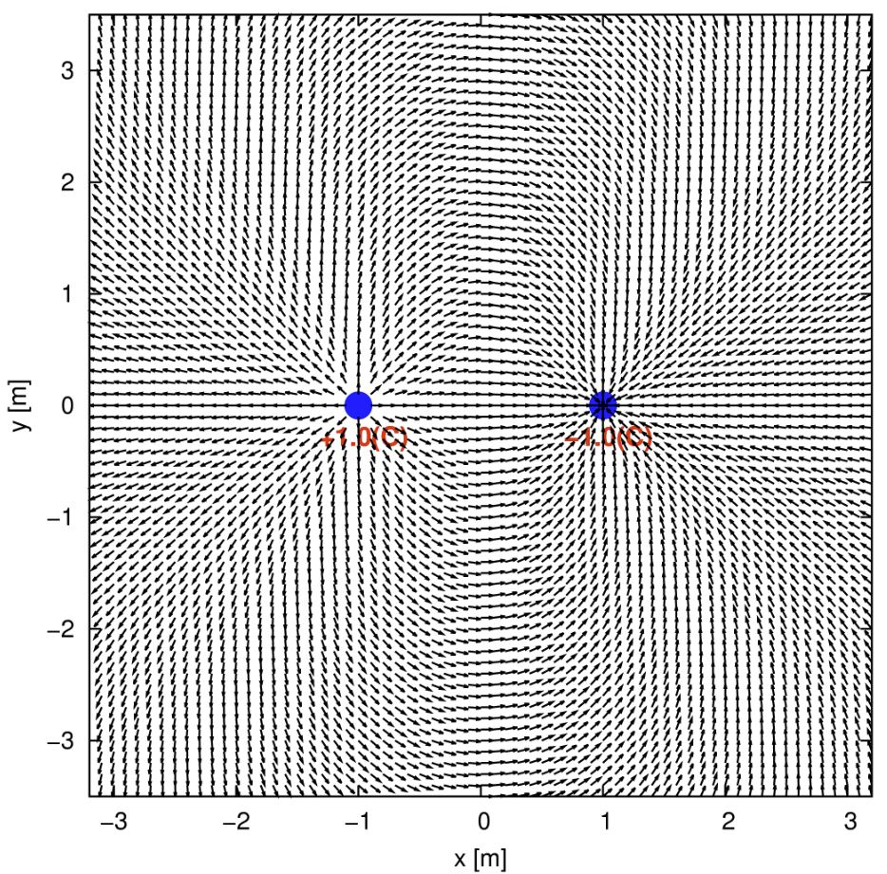
Electric-field and Potential-energy Sim. LAB
Objective:
Simulate the field and potential profiles for arbitrarily placed point charges
Platform of Development:
C++ and FDM/Aztec Linear Solver
Features:
Solve 2D Poisson Equations
Target of classes:
Fundamentals of Physics
Fundamentals of Electromagnetic
Two point charges: +1/-1 (C)
Equi-potential
Contours
Electric
Fields

